Slide 1

E-Healthcare Group no – 02 Group Dominica

Slide 2
The team and their contributions
Akash Chandra Paul(16301171)- Front End
Sajib Mohajan(16101137)-Diagrams
Niloy Rashed (16101023)-Report Making
Muhammad Tamjid Hossain(16301217)- Back End
Hasan Al Mamun (15101065)-Presentation and Slide making

Slide 3
Facts that kept us Motivated
The inconvenience we go through for our regular checkup
The lack of feasibility in the system
Time and energy we have to waste for a doctors meet up

Slide 4
Explaining about our project
An online platform to get the best treatment from anywhere
Planning
Ensure healthcare to people who are direly in need of it no matter how distant they are.
Analysis
Initially, we are working online but planning to get offline soon.
Design
Ensuring treatment to patients online with our best qualified doctors available
Analysis of current system: Healthcare limited to some certain extent, people offline cannot get our service
Analysis of Proposed System: Treatment from best doctors available, free suggestions and tutorials, get treatment 24/7, freedom to choose the best suited doctor etc .

Slide 5


Designing our system
Our system is currently available on web and soon going to launch a mobile app which is on progress.
Requirements gathering:
Surveys and Research in the corresponding field.
Interviews and Affiliation with the best doctor in various field.
Questionnaire session with diverse patients.

Slide 6
Planning Phase
Identifying business value
Develop work plan
Staff of the project
Cost effective

Slide 7
Hardware
We need servers which is to be operated 24/7 and computers that needs to store the data.
Software
Front End
CSS
HTML
Back End
PHP
Java Script
MySQL
Architectural
Design

Slide 8
Feasibility Analysis
Active participation among doctors and patients.
Reduced cost because of their online availability.
Comfort to talk about topic that is viewed as tabooed.
24/7 availability of doctors or feedbacks
Using latest technology.
Positive impact on the patients.

Slide 9
Tangible
We will take a profit of 20% on every patient interview with doctors.
Despite of 1st month free subscription from online health tutorials they have to subscribe for all facilities later on.
We will take a certain amount during affiliating with the doctors.

Slide 10
Intangible
Patients are satisfied as they can track their physical condition and get notified when their health deteriorates
Patients can get quick support in case of emergency with full subscription with our system.

Slide 11
Functional Requirements
Update Personal Information
Take Appointments
Review Previous Records
Establish Health Plan
Provide Prescription

Slide 12
Non Functional Requirements
Performance
Usability and Human Factors
Security & Privacy
Maintainability
Reliability & Availability

Slide 13
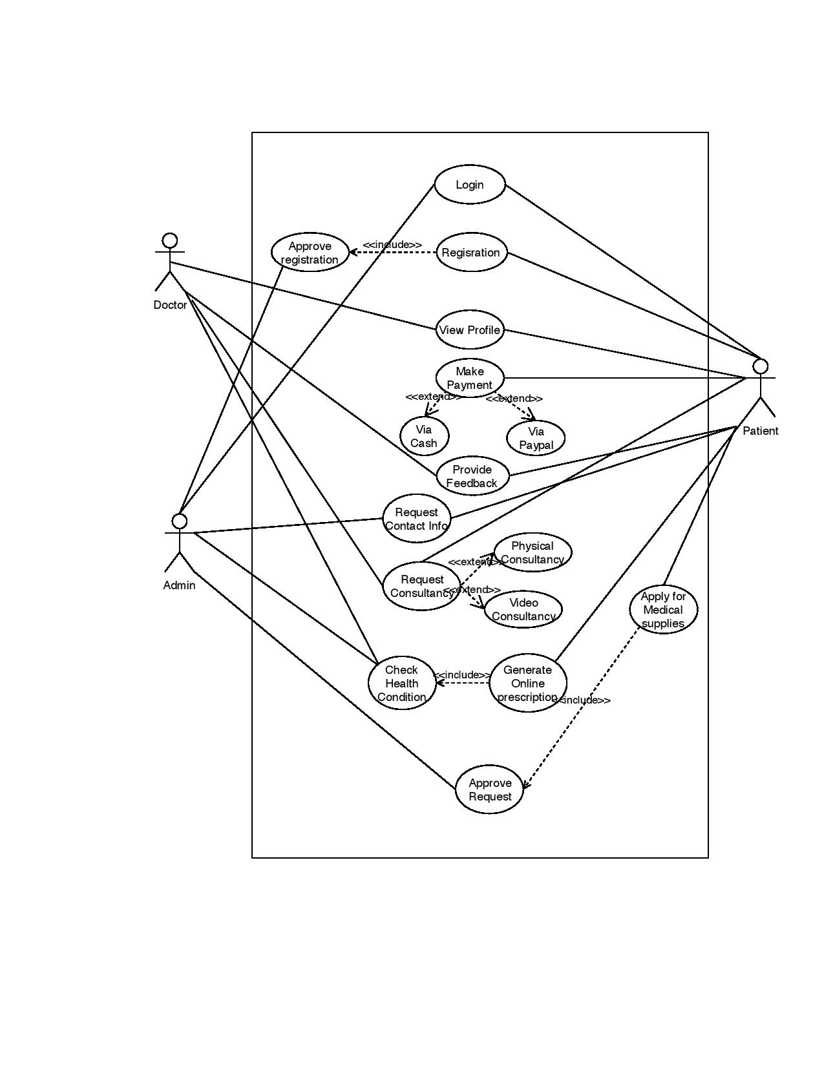
USE Case Diagram

Slide 14
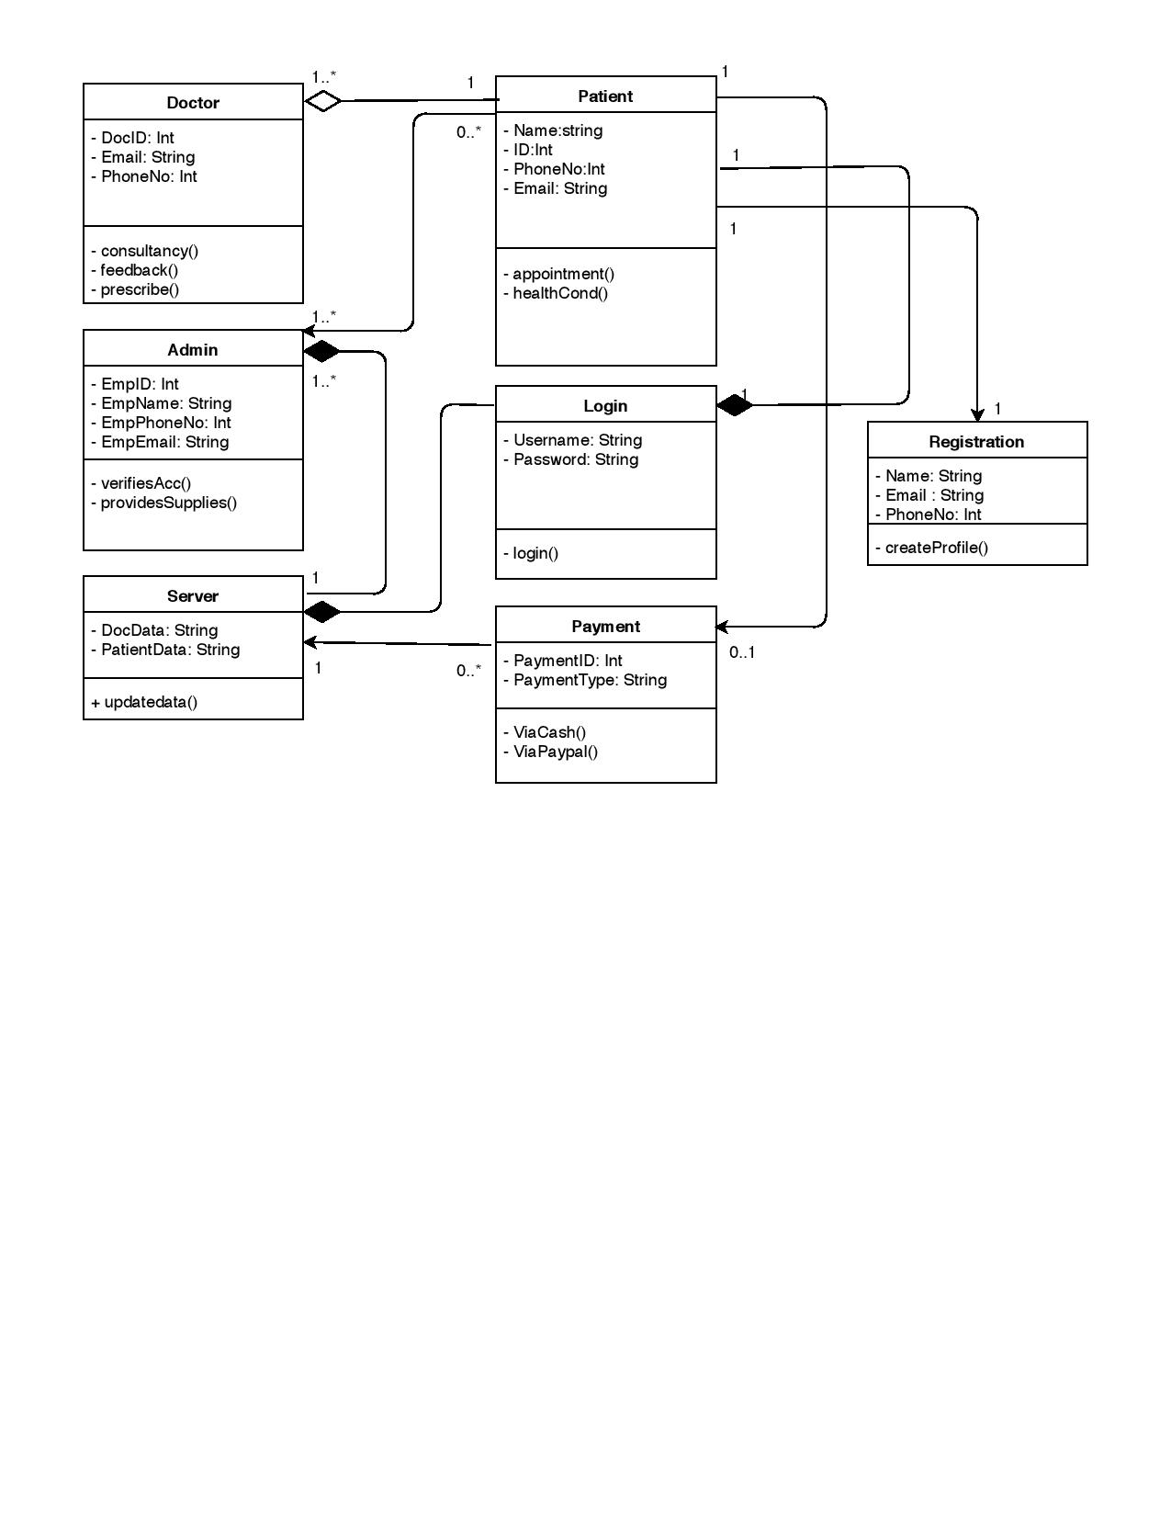
Class Diagram

Slide 15
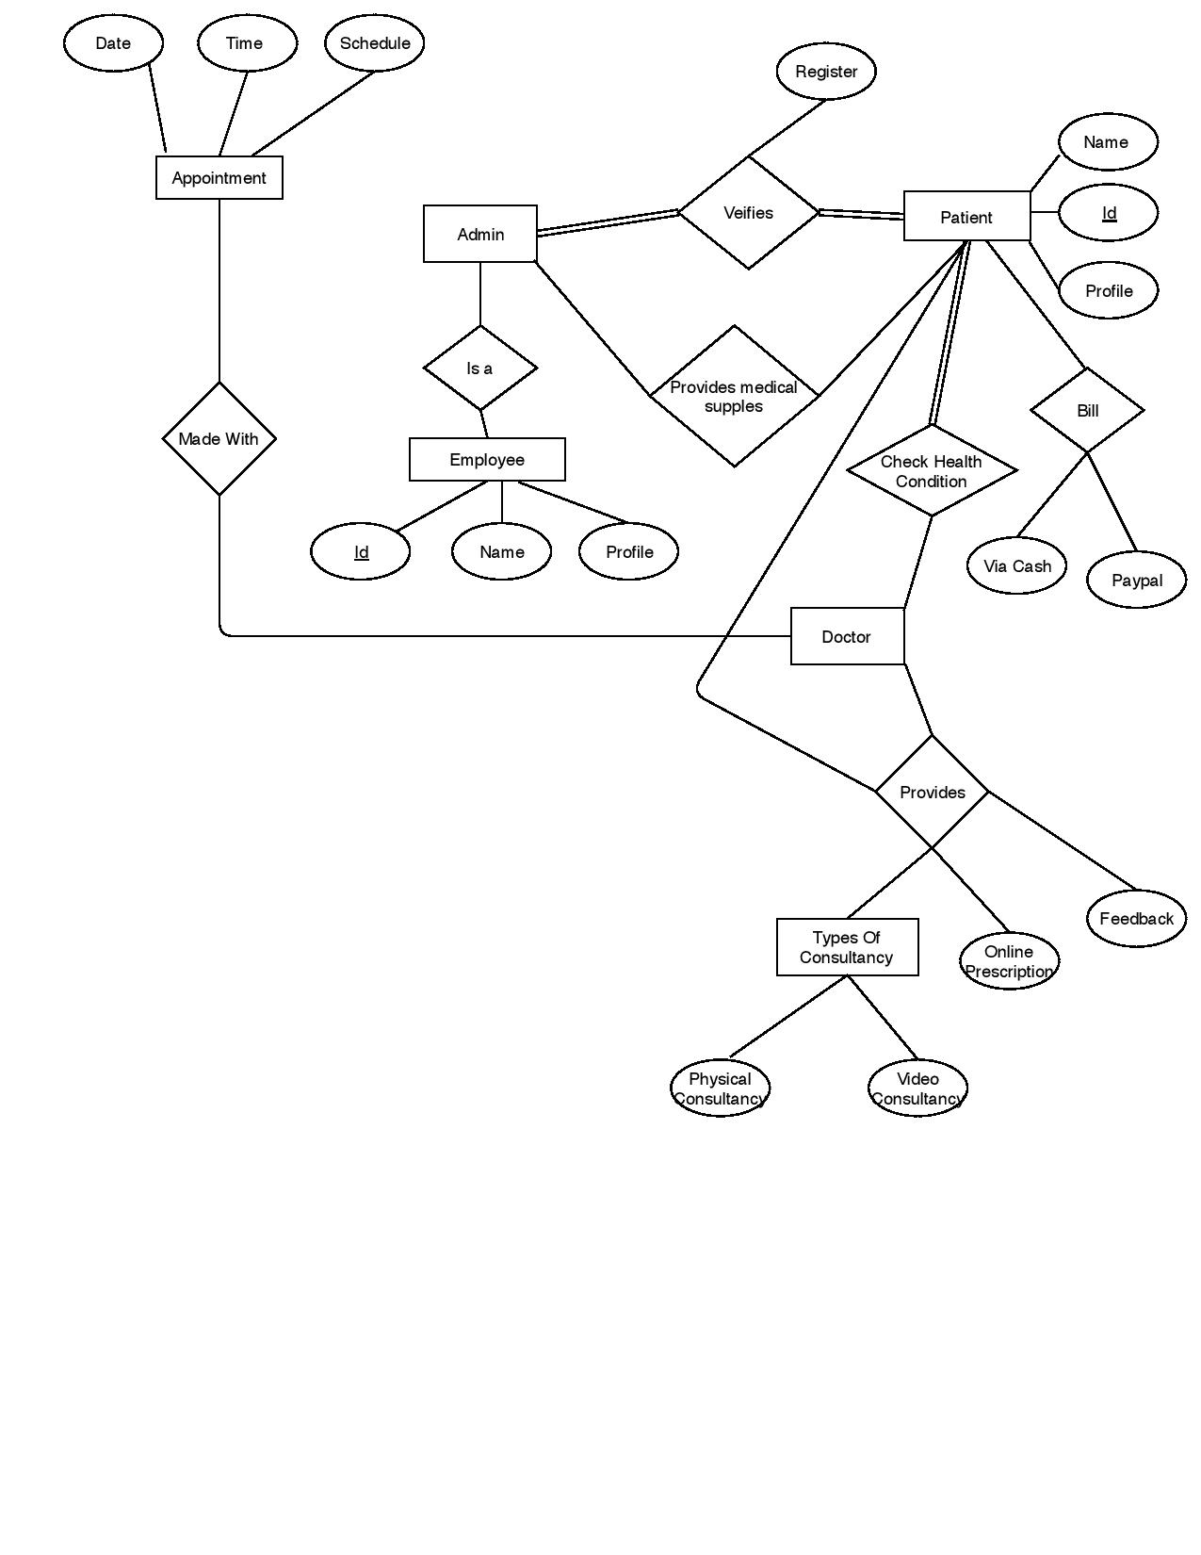
ER Diagram

Slide 16
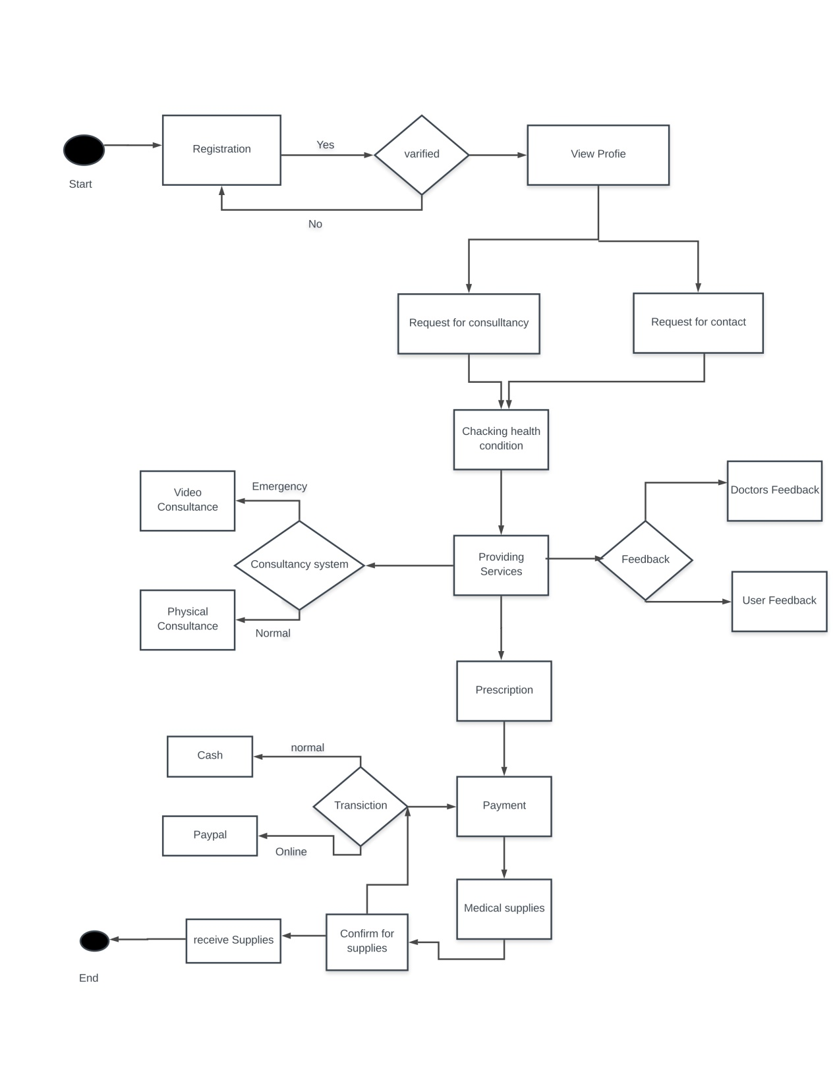
Activity Diagram

Slide 17
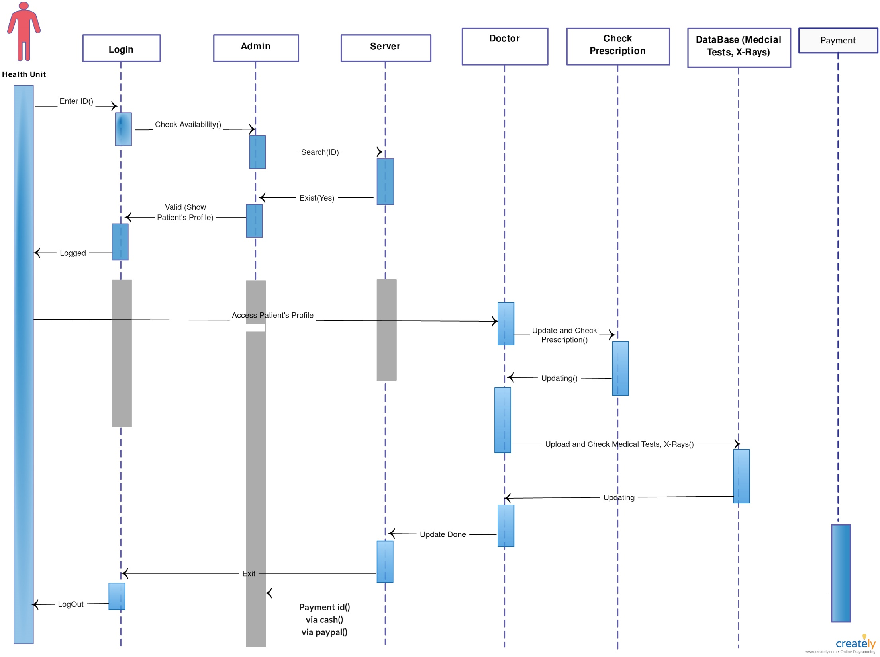
Sequence Diagram

Slide 18
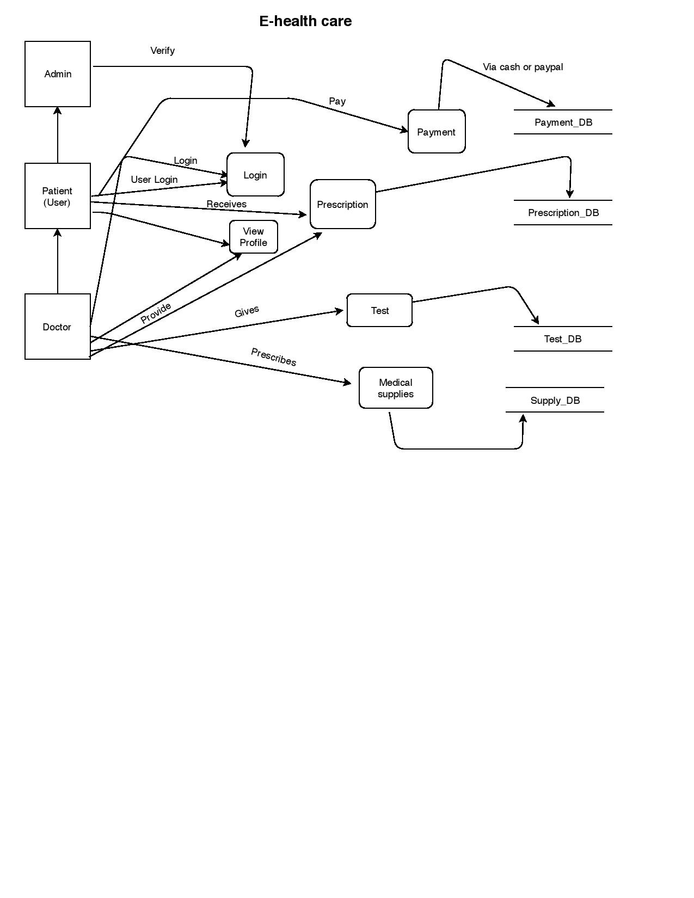
DFD Diagram

Slide 19
Software Testing
Early testing
White-box method
Dealing with extra expense
Dealing with extra time
Challenges

Slide 20
Testing
Unit testing
Integration Testing

Slide 21
Summary and Conclusion
Improvement over the manual system
Ensures reliability
Provides facility of backup
Medical advice for all class

Slide 22
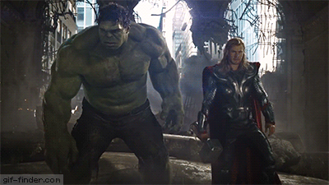
THANK YOU

